Slide 1
Autonomous Robot Control Using GMapping And Navigation On ROS
TEAM MEMBERS:
Shrirang Alias Samarth Patil
Chembeti Munijayanth
Santosh reddy M
Shalini Das

Slide 2
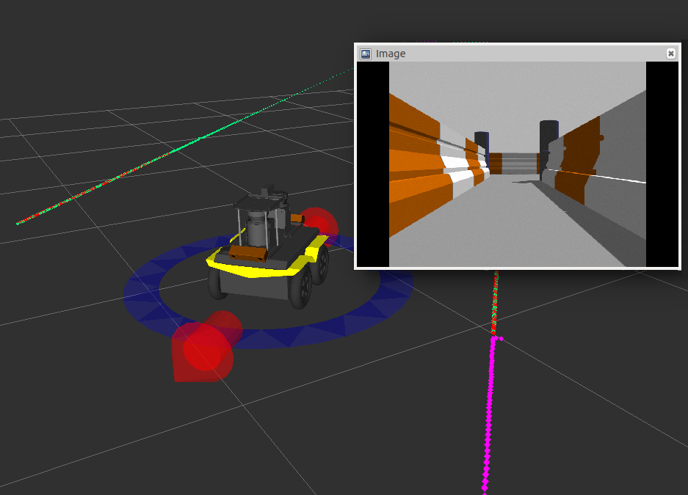
Introduction….
Our aim was to build an autonomous navigation platform for indoor application. we are checking the efficiency of a SLAM (Simultaneous Localization and Mapping) based robot model implemented in ROS (Robot Operating System). The test is done in a virtual environment created by Rviz. By placing different dynamic obstacles for different destinations in the map.

Slide 3
Model Description…
ROS: Meta Operating system with which the project is developed.
Robot: A 4 Wheeled robot built according to URDF integrating with the Hokuyo sensors and plugins(name)
Gazebo: Building a gazebo world environment with the surrounding walls and placing obstacles while simulation.
Rviz: Used for developing map for the simulation and a navigation medium for robot deployment and further functionalities.

Slide 4
Workflow…
Creating Workspace
Building Robot
Creating Gazebo Environment
Buiding Robot Navigation
Creating &Saving Environmental
Map
Deploying Robot
Performing Navigation

Slide 5
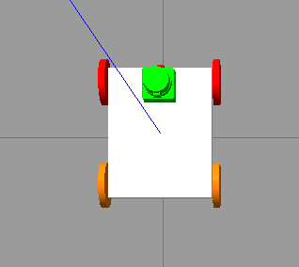
Robot
We built a 4 wheeled Robot model using URDF and Xacro techniques in the ROS, so that should be interacting with the robot application in the Gazebo Simulator.
Integrating it with the Hokuyo Sensor Meshes and skid_steer_drive_controller plugin and finally it looks like

Slide 6
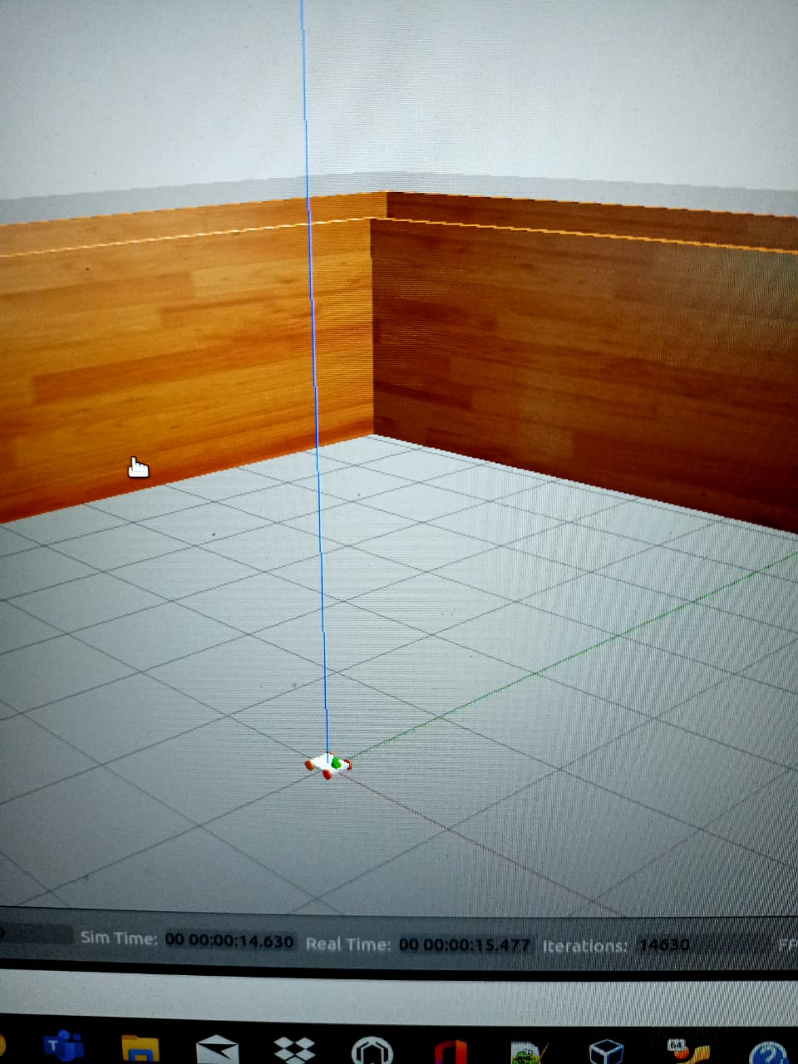
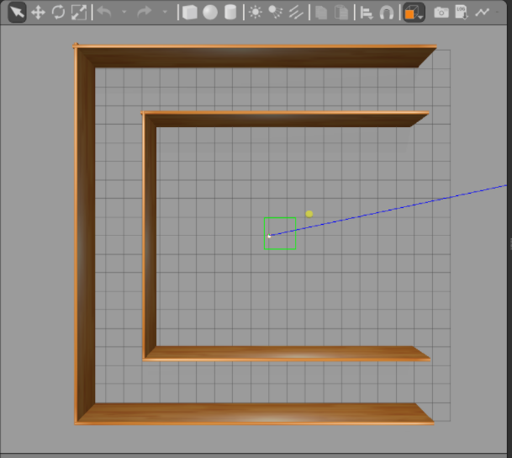
Gazebo World
An Environment is required for Robot to perform its designated functions so a gazebo world is created for the robot with a 3 sided enclosed walls through URDF and when deployed with robot it looks like this.
A new ROS package is needed inside with the name of mybot_gazebo to automatically launch the robot in the Gazebo world with a Robot simulated environment.

Slide 7
Gmapping and Navigation
A new package is needed with the name of mybot_navigation which consists of a GMapping launch file, amcl navigation launch file, and some navigation configuration files.
config files are containg local planner yaml files Which has some base planner properties in it.Costmap planner files with costmap properties in it. And finally global and local costmap parameter files(yaml) with global and local costmap properties.
All the above mentioned files are required for Robot Autonomous Navigation.

Slide 8
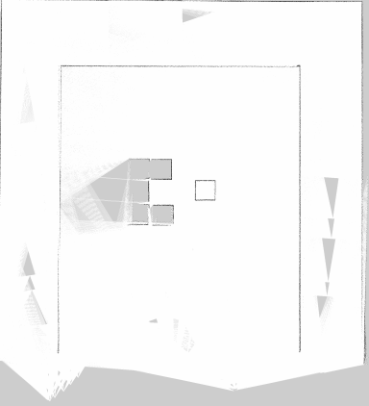
A Simulation Map Environment
To test the Autonomous Robot Navigation application you require a simulation environment map. And in the Trained simulation environment the robot will navigate in it.
Using rviz the map is created and it looks like,

Slide 9
Navigation of The Robot Inside The Simulation Environment
First we Deploy the robot model in gazebo world environment And navigation files such as amcl.
Next we launch Rviz and add the robot ,map created and all the required parameters in performing Autonomous Navigation.
we use 2D Nav Goal operation tool and set the path to move the robot in that path and check how the robot moves in Rviz and the Gazebo simulator.

Slide 10
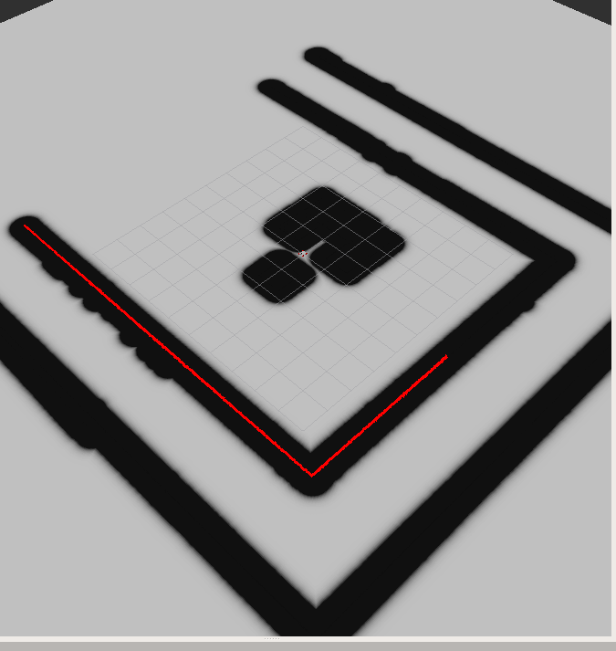
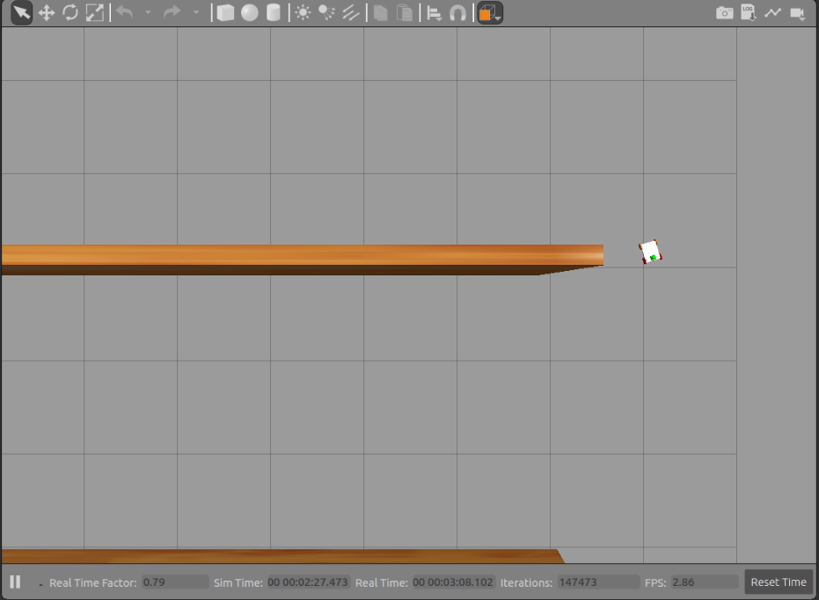

Slide 11
THANK YOU

